Slide 1

WHITE-COLLAR RECESSION(A PHRASE OR A CURSE)

Slide 2

WHAT IS RECESSSION ?
A recession is a significant, pervasive, and persistent decline in economic activity.
Recession may lasts as a little as a few months, but the economy may not recover from its former peak for years

Slide 3
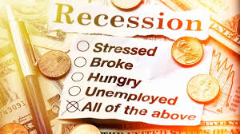
EFFECTS OF RECESSION
Recession brings Unemployment.
Economic output and consumer spending drops.
Interest rates are also likely to decline by central banks to support the economy.

Slide 4

TECH LAYOFFS START OF WHITE COLLAR RECESSION ?
There has been a huge number of layoffs across the tech industries so far, some analysts suggesting it may be a start of a ‘white collar recession’.
White collar recession is not a official term but the idea is that the white collars, the tech company employees, section hit hardest by upcoming recession.

Slide 5

MAJOR LAYOFFS IN INDIAN TECH INDUSTRY
So far, 17,989 employees have been laid off by 52 startups, including unicorns BYJU’S, Chargebee, Cars24, LEAD, Ola, OYO, Meesho, MPL, Innovaccer, Udaan, Unacademy and Vedantu.
Edtech has seen the most layoffs, followed by consumer services and ecommerce. The three sectors have collectively seen 31 startups lay off 15,424 employees so far.
Edtech startup FrontRow laid off a total of 275 employees.
Insurtech Plum fires 10% employees citing restructuring
Hirect fires 200 employees citing restructuring
Sharechat parent company shuts its fantasy cricket subsidiary Jeet11, fires 100 employees.

Slide 6
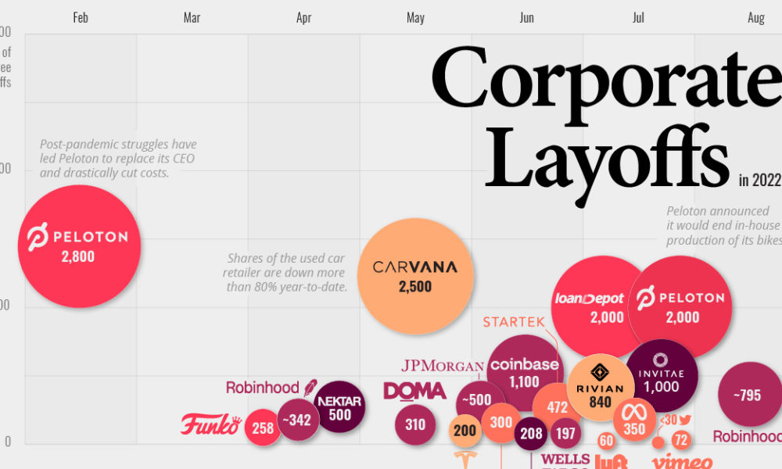
VISUALISING MAJOR LAYOFFS IN U.S.CORPORATIONS

Slide 7

MAJOR U.S CORPORATES LAYOFFS
Amazon laid off 10,000 employees. Largest job cuts in company’s history.
Meta, parent company of Facebook laid off 11,000 employees.
Twitter laid off nearly 3,700 employees as it was expected after Elon Musk acquisition.
Snap and Intel laid off 20% of their workforce.
Microsoft laid off nearly 1000 employees across roles in different parts of world

Slide 8
AS SURE AS THE SPRING WILL FOLLOW THE WINTER
PROSPERITY AND ECONOMIC GROWTH WILL FOLLOW
RECESSION

Slide 9
THANK YOU

